Slide 1

Automatic Gun Detection and Recognition using Deep Learning
Presented by
245622733002: ADDAGULLA ISHIKA
245622733303: CHOLLETI SRI VARSHINI
245622733304: GOPU SREEJA
Students of CSE -A
Name of the Guide: Dr V. HARIKA

Slide 2
Abstract
Real-time object detection to improve surveillance methods is one of the sought-after applications of Convolutional Neural Networks (CNNs). This research work has approached the detection of handguns in areas monitored by cameras . Gun violence and mass shootings are also on the rise in certain parts of the world. Such incidents are time sensitive and can cause a huge loss to life and property. Hence, the proposed work has built a deep learning model based on the YOLOv3 algorithm that processes a video frame-by-frame to detect such anomalies in real-time and generate an alert for the concerned authorities.
Key Words: Convolutional Neural Networks(CNN),Surveillance methods,YOLOv3 Algorithm

Slide 3




Requirements for the Proposed Project
Hardware Requirements:
Processor: Intel i3 and above.
RAM: 8GB and above.
Hard Disk: 512 GB and above.
Key Board: Standard Windows Keyboard.
Monitor:14 colour Monitor.
Software Requirements:
Operating system: Windows 7 and above.
Programming Language: Python.
Front-End : HTML, CSS, JavaScript, Python.
Back-End: Django.
Data Base: MySQL.

Slide 4

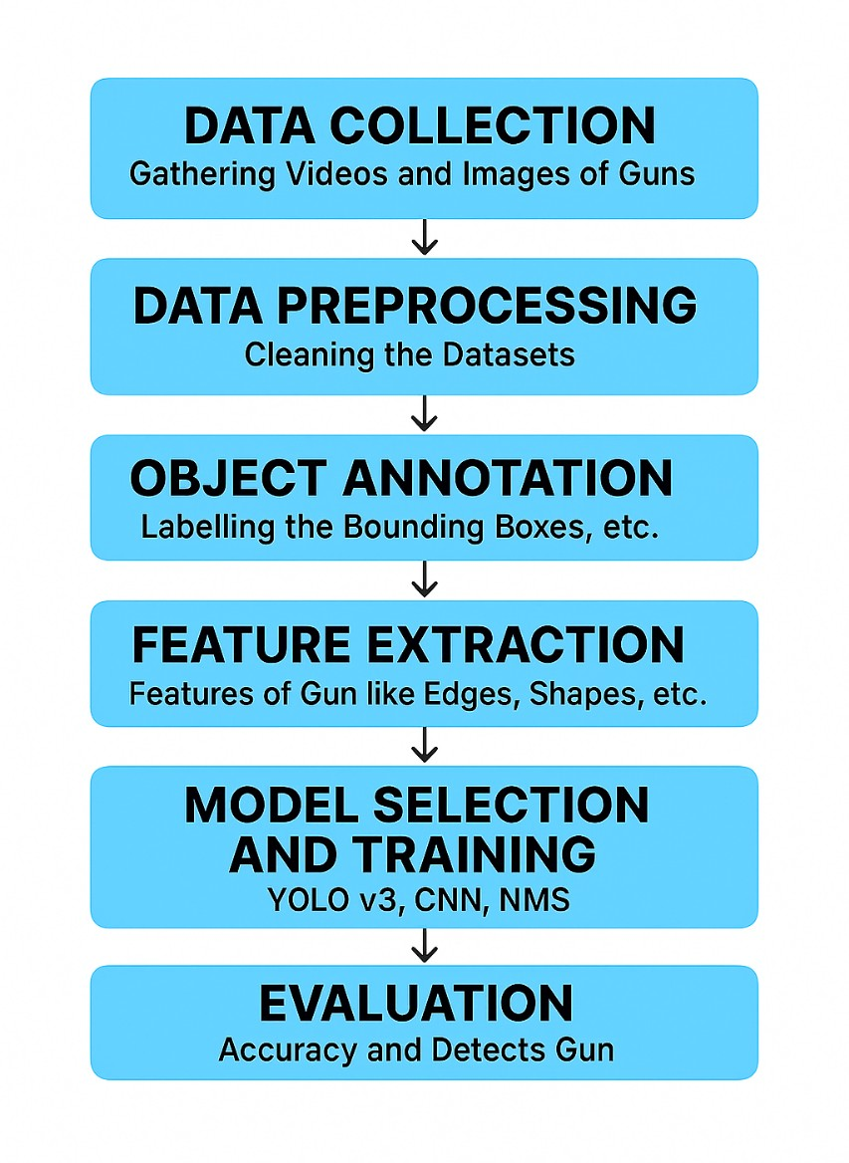
Proposed Methodology

Slide 5
References
A. Castillo, S.Tabik, F. P´erez, R. Olmos, and F. Herrera, “Brightness guided preprocessing for automatic cold steel weapon detection in surveillance videos with deep learning,” Neurocomputing, vol. 330, pp. 151–161, 2019.
Brightness guided preprocessing for automatic cold steel weapon detection in surveillance videos with deep learning – ScienceDirect
Warsi, M. Abdullah, M. N. Husen, M. Yahya, S. Khan, and N. Jawaid, “Gun detection system using YOLOv3,” in Proceedings of the 2019 IEEE International Conference on Smart Instrumentation, Measurement and Application (ICSIMA), pp. 1–4, IEEE, Kuala Lumpur, Malaysia, August 2019.
Gun Detection System Using Yolov3 | IEEE Conference Publication | IEEE Xplore
I-SMAC (IoT in Social, Mobile, Analytics and Cloud)(I SMAC), pp. 84–86, IEEE, Palladam, India, December 2019.
Weapon Detection using Yolov4, CNN
K.-E. Ko and K.-B. Sim, “Deep convolutional framework for abnormal behavior detection in a smart surveillance system,” Engineering Applications of Artificial Intelligence, vol. 67, pp. 226–234, 2018.
Deep convolutional framework for abnormal behavior detection in a smart surveillance system - ScienceDirect

Slide 6
THANK YOU!

